Slide 1
ANALYSING THE CAUSE OF DEATHS AROUND THE WORLD
Sai Kartheek Mahankali

Slide 2
Contents
Problem Statement
Basic Definitions
Datasets
Data Cleaning
Visualizations and Insights
Regression Analysis
Time Series Analysis
Forecasting next 5 years

Slide 3
Problem Statement
What is the expected death rate due to a non-communicable disease among the populous countries?
Using various open data sources that contain yearly country-wise data on population growth, GDP, Funds allocated to the health sector, etc., we try to identify any striking trends and patterns that help us predict death rate of non-communicable diseases in USA

Slide 4
Basic Definitions
Communicable Diseases
  Diseases caused by pathogens and are spread from one person to another. This project considers communicable, maternal, perinatal and nutritional conditions.
  Examples are Chicken pox, Measles, SARS, Influenza, Tuberculosis, etc.
Non-Communicable Diseases
  Chronic diseases that tend to be of long duration
  Caused by genetic, environmental, behavioral factors
  Examples are Cardio-Vascular diseases, Cancers, Respiratory diseases, Mental Health conditions, etc.

Slide 5
Datasets
We have used 4 datasets for this project as follows –
  WHO Mortality Data – All Causes: 300K observations with 9 columns
  WHO Mortality Data – Communicable Diseases: 298K observations with 10 columns
  WHO Mortality Data – Non-Communicable Diseases: 298K observations with 10 columns
  Global Health Expenditure Data: 4.2K observations with 19 columns

Slide 6
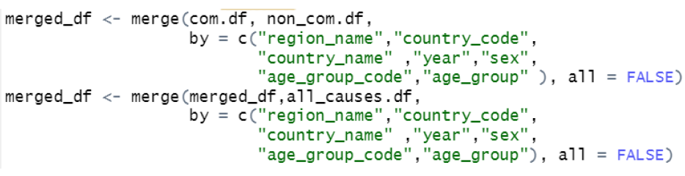
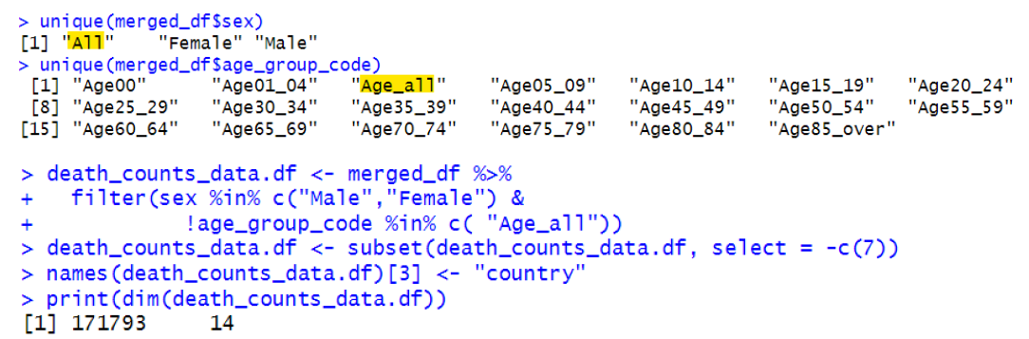
Data Cleaning
Step 1: Merge the datasets
Step 2: Treat the Null values
Step 3: Filter out the redundant Data

Slide 7
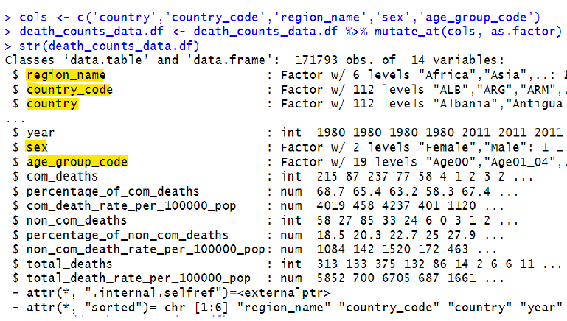
Data Cleaning
Step 4: Convert required variables to categorical

Slide 8
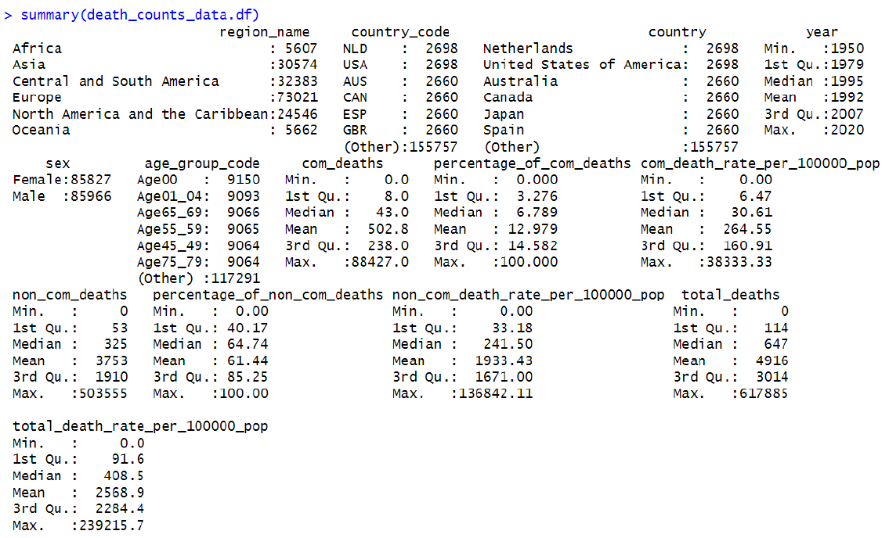
Summary Statistics

Slide 9
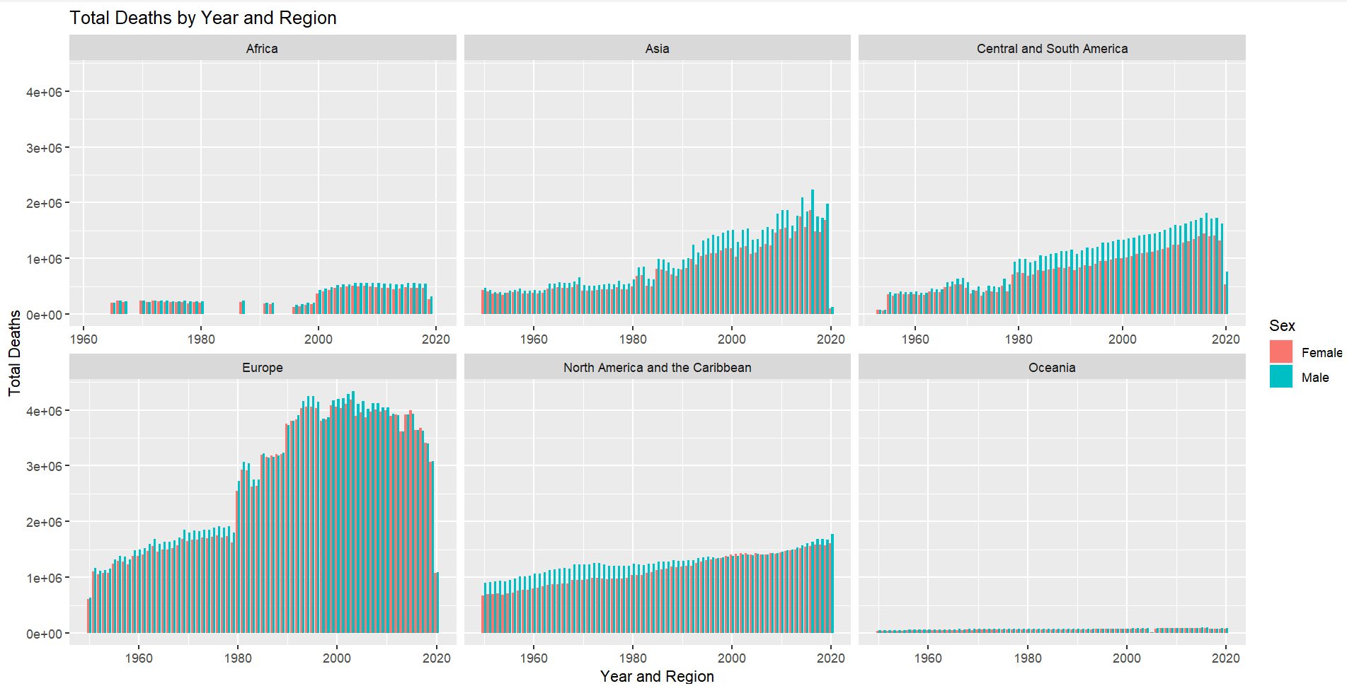
Visualization 1: Total Deaths per Region
Notes:
The take-away from this insight is that we see more male deaths compared to female deaths across the world due to communicable and non-communicable diseases. Another observation is that Europe has seen most deaths compared to other regions (this might be attributed to number of countries in that region and the absence of data about some countries in other regions – ex. India, China, Pakistan, Indonesia etc.)

Slide 10
Insight 1
More male deaths compared to female deaths across the world (https://pubmed.ncbi.nlm.nih.gov/3424846/#:~:text=Age%2Dadjusted%20death%20rates%20in,age%2Dadjusted%20figure%20was%20345.)
Europe has witnessed most deaths from 1950-2019. This insight can be a result of absence of data from countries in Asia and Africa
There seems to be an upward trend in the total deaths across the world – might be attributed to the population explosion

Slide 11
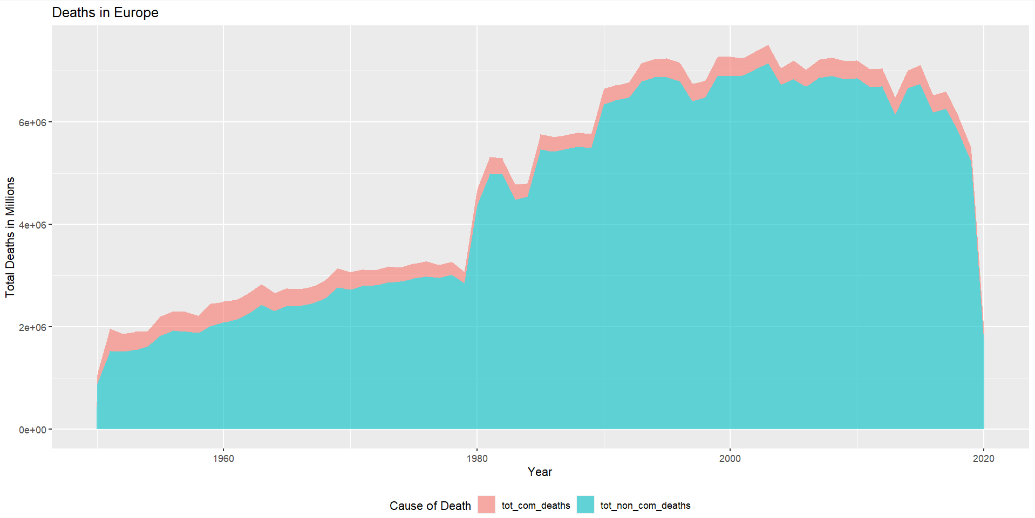
Visualization 2: Com Deaths vs Non-Com Deaths in Europe
Notes:
This plot helps us visualize the impact of non-communicable diseases on human deaths

Slide 12
Insight 2
A huge proportion (about 90%) of deaths in the European region from 1950-2019 are due to non-communicable diseases
https://www.ncbi.nlm.nih.gov/pmc/articles/PMC8701320/#:~:text=Introduction-,Non%2Dcommunicable%20diseases%20(NCDs)%20impose%20a%20heavy%20burden%20on,attributable%20to%20NCDs%20%5B1%5D.

Slide 13
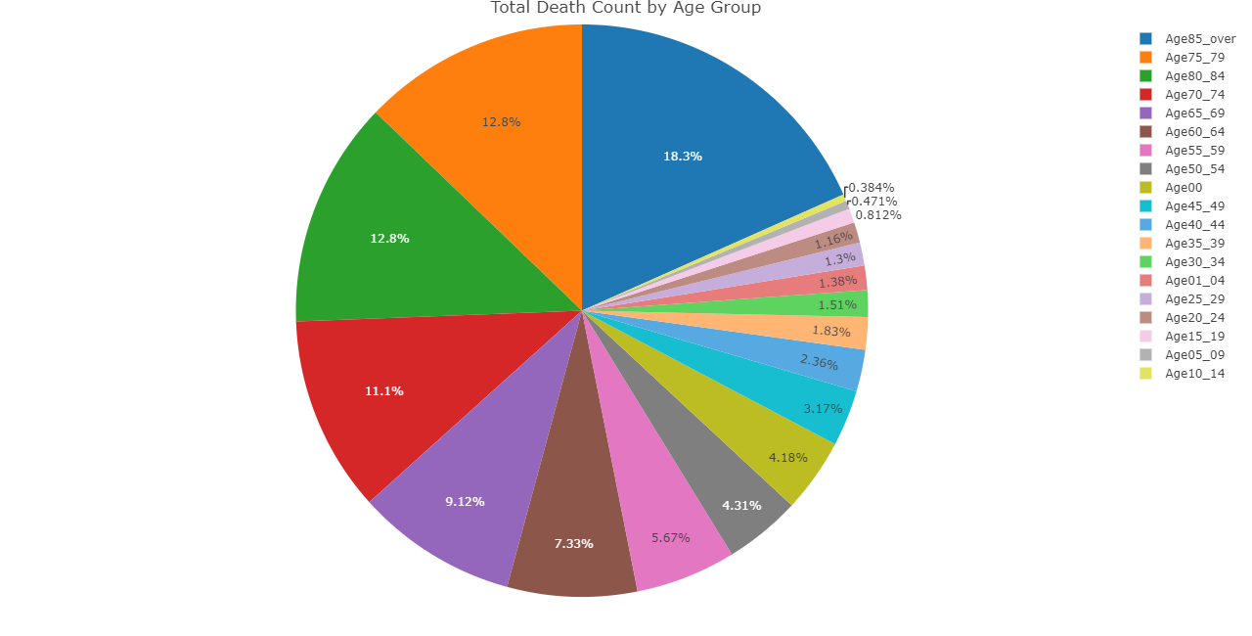
Visualization 3: Spread Of Deaths By Age
Notes:
We observe that the people aged over 85 have the highest death rate, followed by people aged 75-79, followed by 80-84 etc. Key take-away from this insight is that the deaths are proportional to the people’s age, confirming that there has not been any global calamity that has disrupted the age proportions. Another important note is that if we consider only deaths between ages 0-65, new-born deaths attribute to 11.7% of total deaths.

Slide 14
Insight 3
The average life expectancy from1950-2019 is ~70 across the world (https://www.macrotrends.net/countries/WLD/world/life-expectancy)
We see that older population has suffered more deaths than younger population, which infers that no significant global event has taken human lives disproportionately and caused disruption (during the timespan of the data)

Slide 15
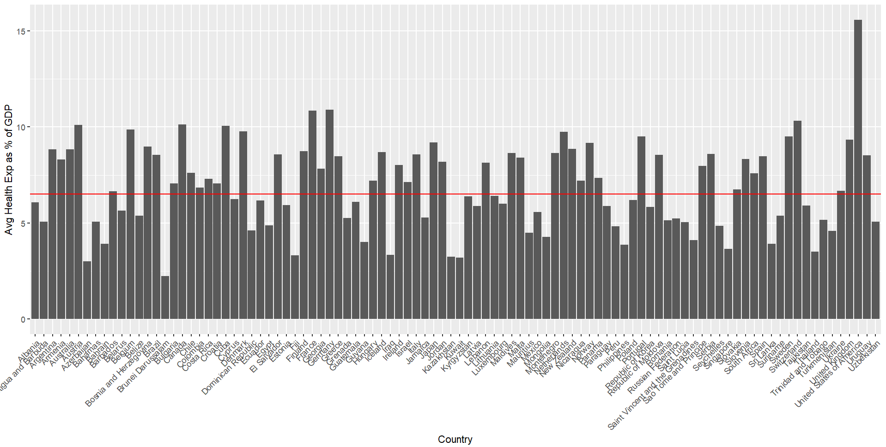
Visualization 4: Health Expenditure as a Percentage of GDP
Notes:
According to the GlobalEconomy.com, the global average health expenditure as a % of GDP is 6.5%. We see that, from the data we have, USA has the highest health expenditure as a % of the GDP. Hence, we choose USA for analyzing the death rates and further forecast.

Slide 16
Insight 4
Global average health expenditure as a % of GDP is 6.5 (https://www.theglobaleconomy.com/rankings/health_spending_as_percent_of_gdp/#:~:text=Health%20spending%20as%20percent%20of%20GDP%20%2D%20Country%20rankings&text=The%20average%20for%202019%20based%20on%20180%20countries%20was%206.5%20percent.)
From our data, we see that USA allocates the highest portion of their GDP towards health sector at 15%
So, we choose USA for our further analysis to understand and check if the high investment in health sector paid off

Slide 17
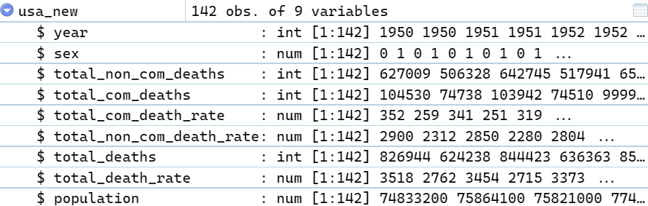
Regression Analysis
Filter USA data for further analysis
Notes:
Note that we are considering year as an integer and not a category as it has effect on the data. Also, we have used label encoding for the “Sex” column to include it into the analysis. The “population” column wasn’t in the original dataset, we had calculated it based on total deaths and total death rate, as the population data is easily available to us on the internet to predict non-com death rates in future. We are going to consider “year”, ”sex”, “total non-com death rate”, and population. “year”, “sex”, and “population” are the features and “total_non_com_death_rate” is the target variable.

Slide 18
Regression Analysis
We consider “year” as integer to include it in the regression
“Sex” is label encoded
Population is calculated based on total deaths and total death rate columns as it is easily available on the internet to forecast future data
Features – year, sex, population
Target variable – Total Non-Com death rate

Slide 19
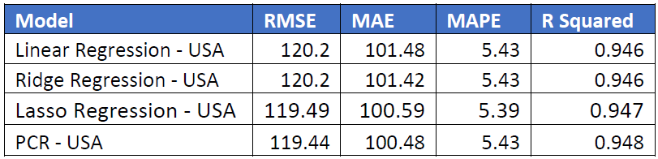
Regression Analysis
Models we used on the USA data:
  Linear Regression
  Ridge Regression (Used to analyze data suffering from Multicollinearity)
  Lasso Regression (Shrinkage and variable selection method)
  Principal Component Regression (Reduces the number of predictors for future analysis)
Notes:
We notice that Lasso Regression has the least RMSE and MAPE, while not compromising on other metrics.

Slide 20
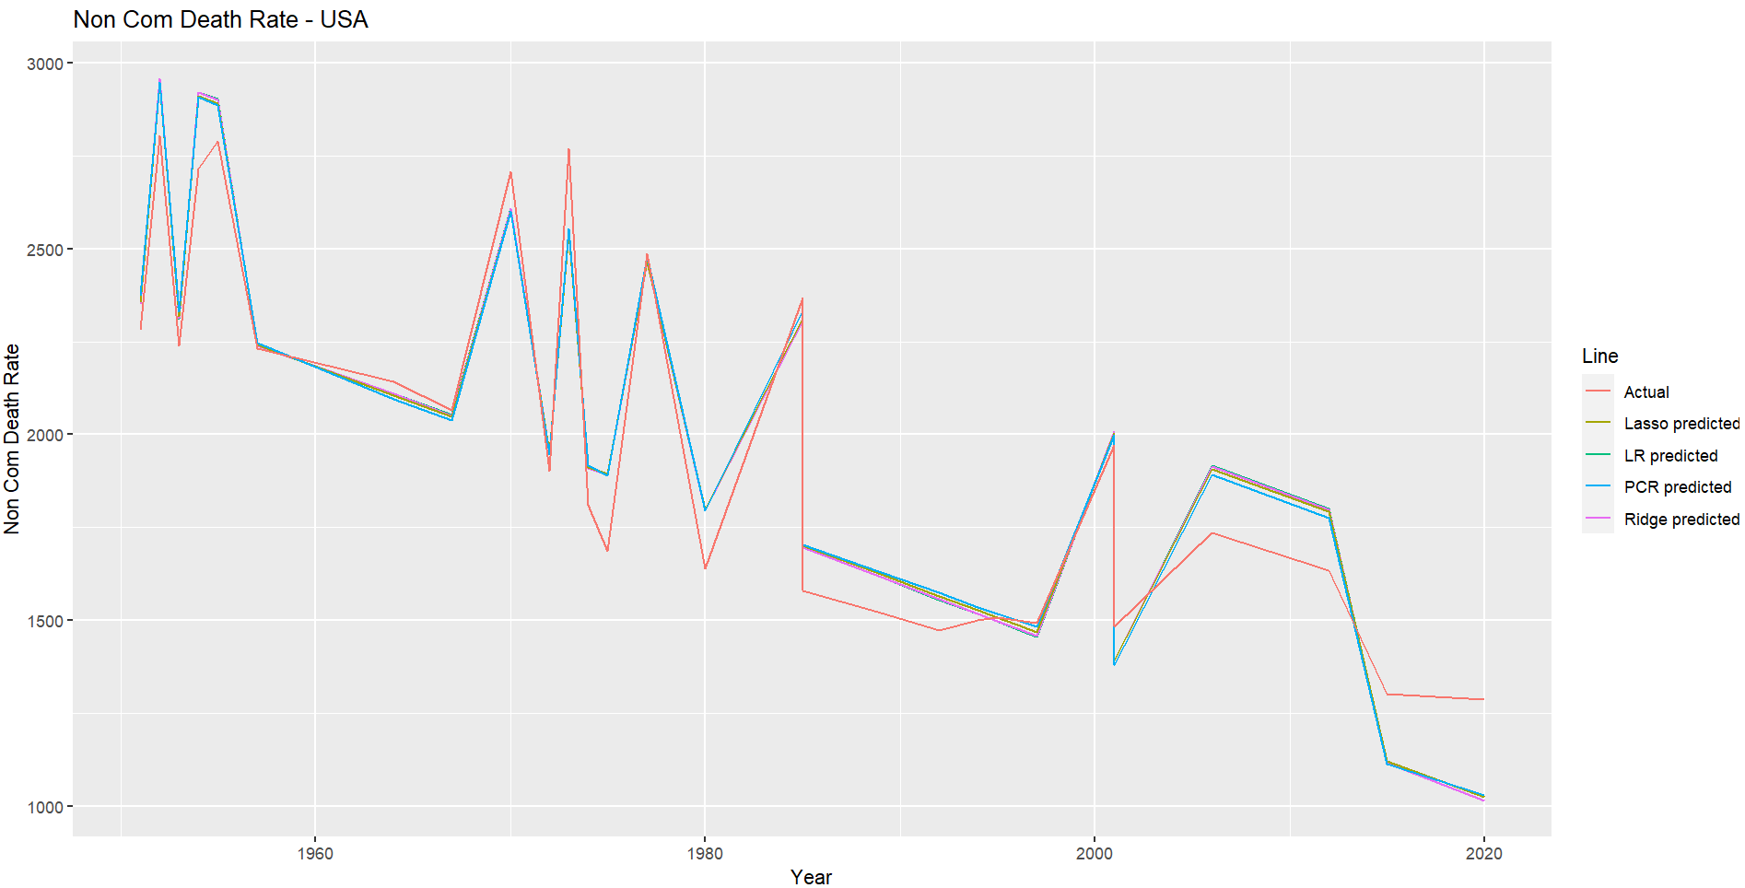
Regression Analysis
Notes:
This is the graph if we consider “sex” in the dataset. The spikes are “male” deaths and dips are “female” deaths

Slide 21
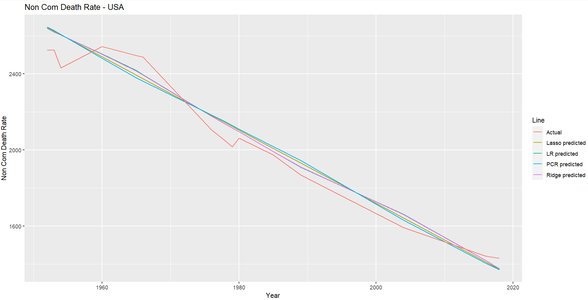
Regression Analysis
Considering total non-com death rate from 1950 irrespective of the gender, we get the below plot -

Slide 22
Time Series Analysis
Time series models we used on the data –
  Drift Model (Amount of change over time is set to be the average change seen in historical data)
  Mean Model (Forecast of all future values is equal to the mean of the historical data)
  Naïve Model (Forecast is same as last value)
  ETS Model (Uses the trend, seasonal and error components to forecast)
  ARIMA Model ( Auto Regressive Integrated Moving Average – Similar to regression)
Notes:
https://otexts.com/fpp2/simple-methods.html

Slide 23
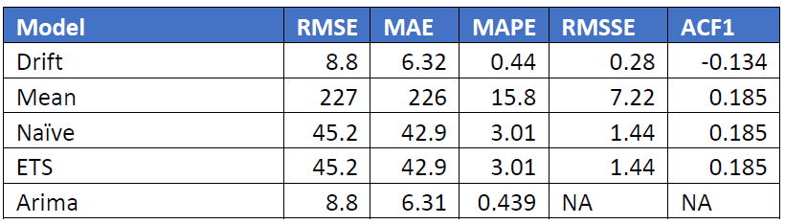
Time Series Analysis

Slide 24
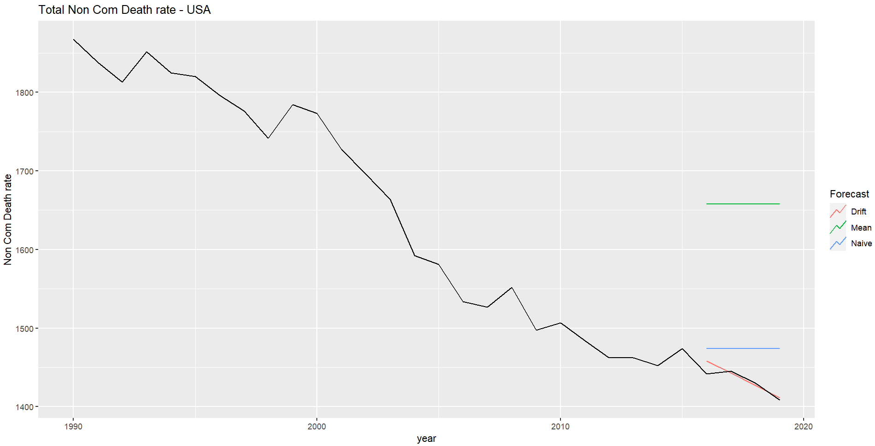
Time Series Analysis

Slide 25
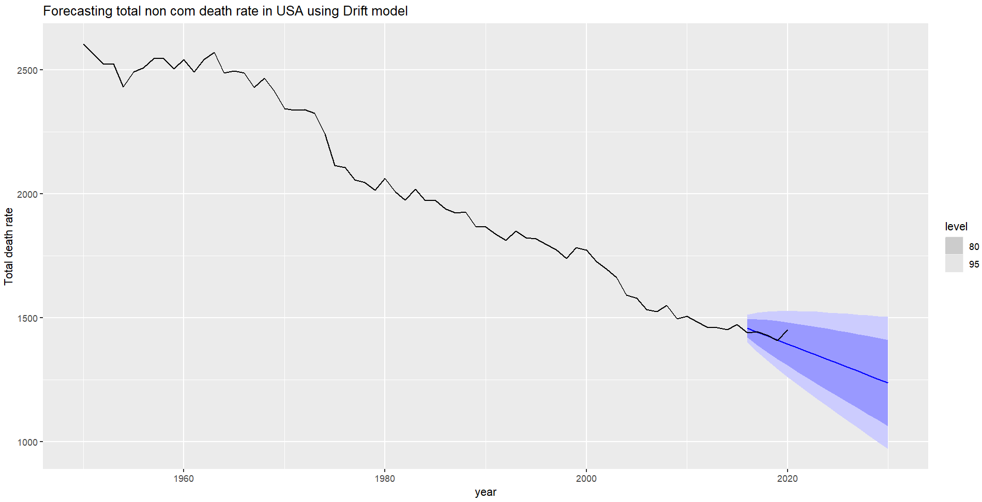
Forecasting the next 5 years

